Slide 1

Tiles and Non-Relational Models
Shreeraksha Achutha
Taranpreet Kaur
Madhuri Nagaraj Hebbale
Sindhuja Madabushi
Supervisor: Gabriel Campero
May 23rd, 2017

Slide 2
Structure
1. Team Roles
2. Topic Introduction
Data Models
Mapping from RDBMS to :
Key Value Stores
Key Value Column Stores
Graph based models (RDF/Property Graphs)
3. Project Progress

Slide 3
Team Roles for M2 :-
Shreeraksha Achutha
Program: Data and Knowledge Engineering
Main tasks: prototypical implementation (Developer)
Taranpreet Kaur
Program: Digital Engineering
Main tasks: Literature research, paper presentation (Database Architect)
Madhuri Nagaraj Hebbale
Program: Data and Knowledge Engineering
Main tasks: Literature research, paper presentation (Manager)
Sindhuja Madabushi
Program: Data and Knowledge Engineering
Main tasks: Prototypical implementation (Developer)

Slide 4
Data Models
A data model is an abstract model that organizes elements of data and standardizes how they relate to one another and to properties of the real world entities.
A data model theory has three main components:
The structural part - a collection of data structures which are used to create databases
The integrity part - a collection of rules governing the constraints (structural integrity)
The manipulation part (operator) - a collection of operators which can be applied to the data structures ( query and update data)

Slide 5
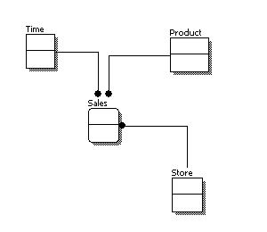
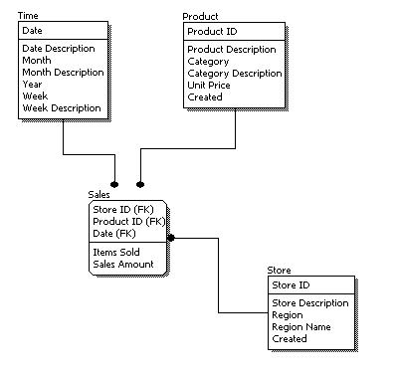
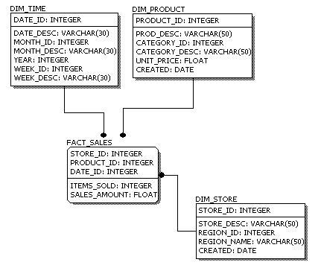
Types of Data Models
Conceptual Data Model - describes the semantics of a domain (the scope of the model).
Logical Data Model - describes the structure of some domain of information.
Physical Data Model - describes the physical means used to store data.

Slide 6
Key Value Store Models
A key-value store is a simple hash table, primarily used when all access to the database is via primary key.
The client can either (Operations) -
get the value for the key
put a value for a key
delete a key
How to Construct a Key ?
Define meaningful names(entity, attributes).
Entity Name + ':' + Entity Identifier +':' +Entity Attribute
Eg :Cust:7348:Age

Slide 7
Data Representation Strategy - Key Value stores

Slide 8
Mapping of RDBMS to Key Value Stores
USERS
ID | NAME | LAST NAME | ADDRESS ID
1 | Sherlock | Holmes | 1
2 | John H. | Watson | 1
3 | Theresa | May | 2
ADDRESS
ID | STREET AND NUMBER | CITY | FLOOR
1 | 221b Baker St | London | 1st floor
2 | 10 Downing Street | London | NULL

Slide 9
Mapping of RDBMS to Key Value Stores
Key | Value
user/Sherlock | {“Name”: “Sherlock”, “Last Name”: “Holmes”, “Address”:”address/Baker221b ”}
user/Watson | {“Name”: “John H.”, “Last Name”: “Watson”, “Address”:”address/Baker221b ”}
user/Theresa1 | {“Name”: “Theresa”, “Last Name”: “May”, “Address”:”address/Downing10 ”}
address/Baker221b | {“StreetAndNumber”: “221b Baker St.”, “City”: “London”, “Floor”:”1st Floor”}
address/Downing10 | {“StreetAndNumber”: “10 Downing Street”, “City”: “London”}
The key is an index in the key-value store.
For a foreign key relation we can instruct the application to interpret values as Keys. eg: “user/Sherlock” = {“Name”: “Sherlock”, “Last Name”: “Holmes”, “Address”:”address/Baker221b ”}
No integrity constraints (unlike RDBMS)

Slide 10
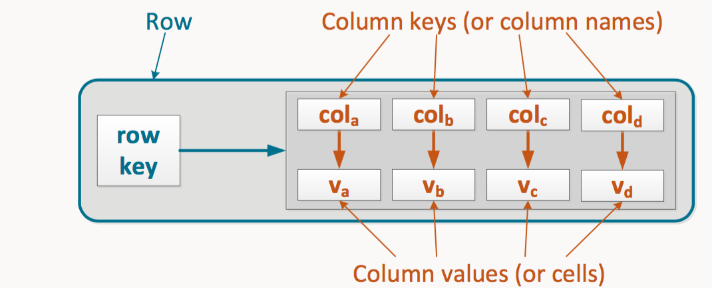
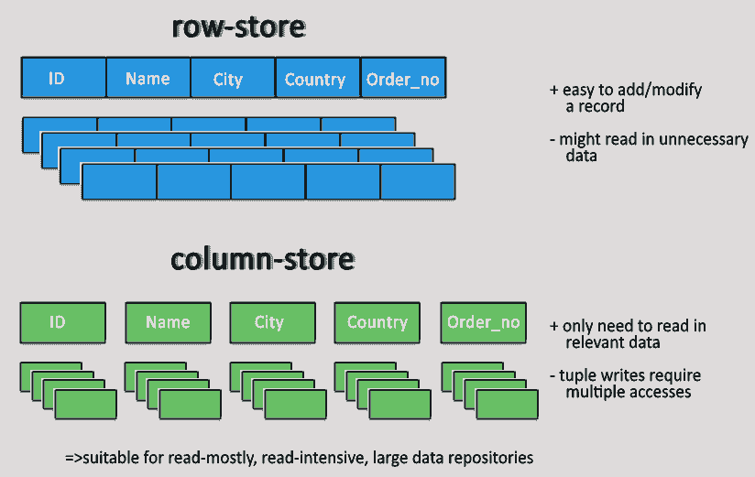
Key Value Column Stores /Extensible Record stores
A table is a collection of column families.
Column Family - logical and physical grouping of columns
Row-Key is an implicit primary key to uniquely identify the record.
Every row in a table can have different set of columns identified by its row-key.

Slide 11
Key Value Column Stores /Extensible Record stores
NAME COLUMN FAMILY
NAME | LAST NAME
{“Name”: “Sherlock”} | {“Last Name”: “Holmes”}
{“Name”: “John H.”} | {“Last Name”: “Watson”}
{“Name”: “Theresa”} | {“Last Name”: “May”}
ID
1
2
3
Operations(DynamoDB) -
putItem(table, key, av)
getItem(table, key)
deleteItem(table, key)
Language- Cassandra Query Language(CQL)
No integrity constraints (unlike RDBMS)

Slide 12
Mapping of RDBMS to Key Value Column Stores
Key Value Column Stores /Extensible Record stores
ADDRESS COLUMN FAMILY
STREETANDNUMBER | CITY | FLOOR
{“StreetAndNumber”: “221b Baker St.”} “Floor”: “1st Floor”} | {“City”: “London”}
{“StreetAndNumber”: “221b Baker St.”} “Floor”: “1st Floor”} | {“City”: “London”}
{“StreetAndNumber”: “10 Downing Street”} | {“City”: “London”} | {“Floor”:”1st Floor”}
ID
1
2
3

Slide 13
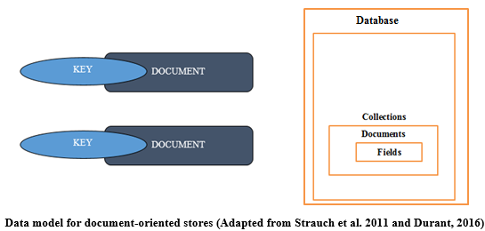
Document Stores
A document store, is a computer program designed for storing, retrieving and managing document-oriented information, also known as semi-structured data.
Document-oriented databases are inherently a subclass of the key-value store (difference -> Data Processing)
Storage : All information for a given object in a single instance in the database, and every stored object can be different from every other(unlike RDBMS).

Slide 14
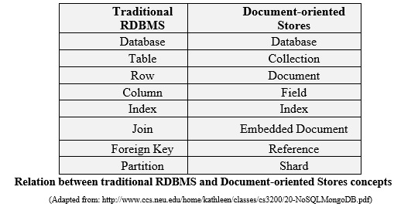
Document Stores
Additional Metadata - stored along with the document content.
Operations (CRUD) -
Creation (or insertion)
Retrieval (or query, search, finds)
Update (or edit)
Deletion (or removal)
Retrieval -
Unique key
Index on the key
Deletion (or removal)
API
Query Language (XQuery)

Slide 15
Mapping of RDBMS to Document Store
{ “Users”: [ {“id”: 1, “Name”: “Sherlock”, “Last Name”: “Holmes”, “Address”:{ “StreetAndNumber”: “221b Baker St.”, “City”: “London”, “Floor”:”1st Floor” } } {“id”: 2”, “Name”: “John H.”, “Last Name”: “Watson”, “Address”: { “StreetAndNumber”: “221b Baker St.”, “City”: “London”, “Floor”:”1st Floor” }...

Slide 16
Mapping of RDBMS to Document Store
... {“id”: 3, “Name”: “Theresa”, “Last Name”: “May”, “Address”:{ “StreetAndNumber”: “10 Downing Street”, “City”: “London”} } ] }
Nested Relations (each document can have another document)
No integrity Constraint (Encoding – Documents depend on encoding)
Encodings - XML, YAML, JSON, and BSON, as well as binary forms like PDF and Microsoft Office documents (MS Word, Excel, and so on)

Slide 17
Graph Database Management Systems(GDBMSs)
In GDBMSs data are stored as graphs and queries are expressed as traversal operations. This allows applications to scale to very large graph-based data sets.
In addition, since GDBMSs do not rely on a rigid schema, they provide a more flexible solution in scenarios where the organization of data evolves rapidly and dat is highly interconnected in nature like Semantic Web etc.
[https://goo.gl/images/sxJlGB]

Slide 18
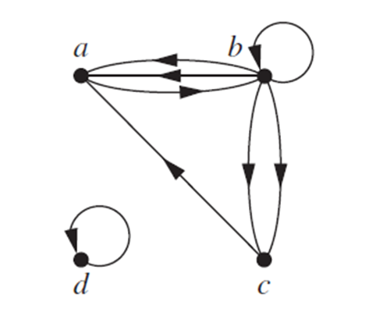
Property Graphs
A property graph, is a labeled and attributed directed multigraph with identifiers.
What is a Multigraph ?
Types for nodes and edges
Node label denotes the corresponding node type.
Edge label denotes the corresponding edge type(unique).
The name:value pairs(attributes) describe properties of a node or edge
Integrity - No (all data items have to have ids, edges have to have a source and a target vertex).
Languages - Gremlin,Cipher

Slide 19
Mapping of RDBMS to Property Graphs
USERS
ID | NAME | LAST NAME | ADDRESS ID
1 | Sherlock | Holmes | 1
2 | John H. | Watson | 1
3 | Theresa | May | 2
ADDRESS
ID | STREET AND NUMBER | CITY | FLOOR
1 | 221b Baker St | London | 1st floor
2 | 10 Downing Street | London | NULL

Slide 20
Mapping of RDBMS to Property Graph

Slide 21
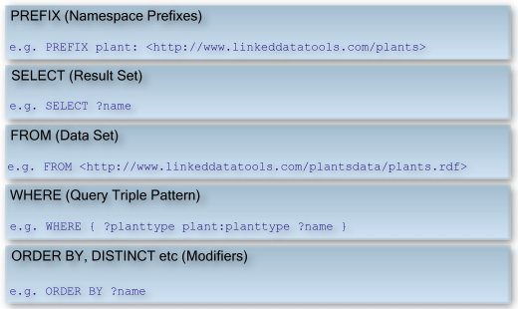
RDF(Triplestore)
What does RDF stand for ???
Resource Description Framework - databases which store data in the format
subject-predicate-object(directed multigraphs) , which is known as a triple like
"Bob is 35" or "Bob knows Fred”.
How do we retrieve data from RDF ???
Semantic queries - SPARQL
Integrity : No(Edge without
a source vertex and a target vertex is
not allowed).

Slide 22
Mapping of RDBMS to RDF(Triplestore)

Slide 23
Property Graphs vs RDF
[https://goo.gl/images/OD3ONb]

Slide 24
All the models at a glance
Features | RDBMS | DS | KVS | KVCS | PG | RDF
Rigid Schema | Yes | - | - | - | - | -
Flexible Schema | - | Yes | Yes | Yes | Yes | Yes
Hierarchical Data | Yes (Bottleneck - Joins) | Nested Documents | - | - | Yes | Yes
Integrity Constraints | Yes (Enforced by DBMS) | Document Encoding | - | - | Key | Edge has 2 vertexes
Storage | Tables | XML,JSON | Tables | Tables | Graph | Triple
Languages | SQL | XQUERY | Redis | CQL | GREMLIN, CIPHER | SPARQL
Databases | Oracle | MongoDB , CouchDB, Cassandra | Redis , CouchDB | DynamoDB, OracleNOSQL | Neo4j | GraphDB, OracleNOSQL

Slide 25
Project Progress
Milestone | Date | Task Description
Milestone 1 | 12.04 – 02.05 | DONE – Initial Research, Presentation and Team Organization
Milestone 2 | 02.05 – 23.05 | DONE –Structure of the paper, introduction, Research on models and early implementation setup.
Milestone 3 | 23.05 – 13.06 | First draft of the paper, selection of the operators, early results of the implementation
Milestone 4 | 13.06 – 04.07 | FINAL presentation with the results

Slide 26
Thank you!
Questions?

Slide 27
References
Tahara, Daniel, and Daniel Abadi. "SQL Beyond Structure: Text, Documents and Key-Value Pairs." Proc. New England Database Day 2014 (2014).
Holder, Lawrence B., and Diane J. Cook. "Graph-based relational learning: Current and future directions." ACM SIGKDD Explorations Newsletter 5.1 (2003): 90-93.
De Virgilio, Roberto, Antonio Maccioni, and Riccardo Torlone. "Converting relational to graph databases." First International Workshop on Graph Data Management Experiences and Systems. ACM, 2013.
Wiese, Lena. Advanced Data Management: For SQL, NoSQL, Cloud and Distributed Databases. Walter de Gruyter GmbH & Co KG, 2015.
https://en.wikipedia.org/wiki/Document-oriented_database
http://www.tobez.org/presentations/2011-NPW-redis.html
https://en.wikipedia.org/wiki/XQuery
http://www.1keydata.com/datawarehousing/data-modeling-levels.html
https://en.wikipedia.org/wiki/Data_model
https://cambridge-intelligence.com/keylines/nosql-key-value-column-stores/

